Slide 1
Introduction to C++ Programming

Slide 2
Common Data Types in C++
Data Type | Example | Meaning
int | int age = 18; | Integer (whole number)
float | float pi = 3.14; | Decimal number (less precision) to 7 digits.
double | double avg = 75.8; | Decimal (more precision) to 16 digits.
char | char grade = 'B'; | Single character
string | string name = "Ali"; | Text

Slide 3
Problem solving:
1. Ask the user for two numbers and display their product.
2. Ask the user to enter their name, current year, and birth year, then calculates and displays their age with their name.
3. Convert temperature from Celsius to Fahrenheit.
4. Ask the user for the length and width of a rectangle, then calculate and print the area and perimeter.

Slide 4
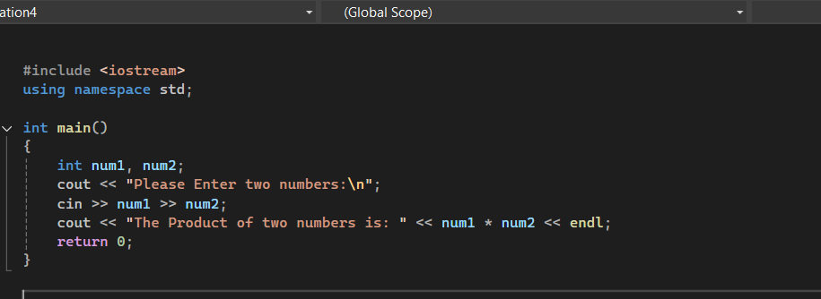
First program

Slide 5
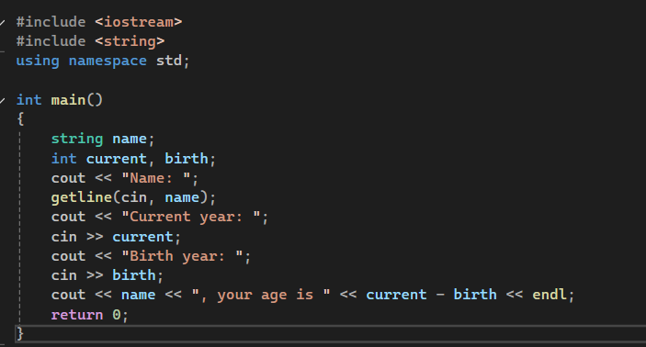
Second program

Slide 6
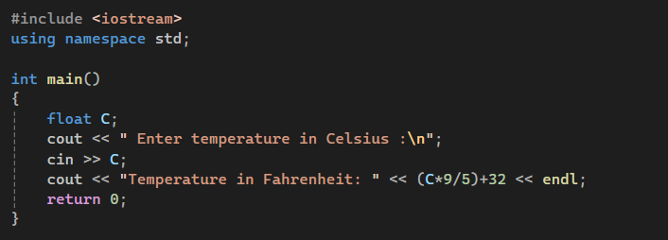
Third program

Slide 7
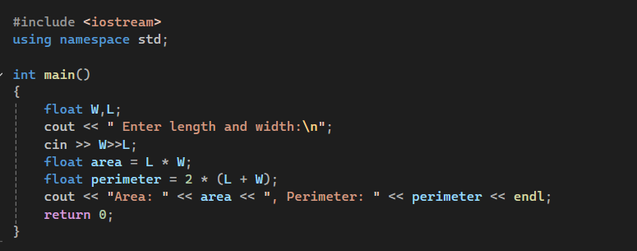
Fourth program

Slide 8
Home Task: Student Grade Checker
Write a C++ program that:
Asks the user to enter their name.
Asks the user to enter their grade in one subject.
Displays both the name and the grade.

